Slide 1



The Ethical Implications
AI-Driven Penetration Testing

Slide 2


Our Team
IT Number | Name | Contribution
IT22897480 | Sheromiga A | Ethical Hacking vs. Malicious Use of AI
IT22031884 | Nurandhi J.A.S | Data Privacy and Consent
IT22560094 | Ranasinghe R.A.D.T.M | Bias and Fairness in AI Models
IT22032188 | Bomal G.D.I | Accountability and Responsibility
IT22005830 | Rathnayaka R.D.D.H | Impact on Employment and Skills

Slide 3

Ethical Hacking vs. Malicious Use of AI: The Fine Line
Sheromiga A

Slide 4

Ethical Penetration Testing
Simulates cyberattacks to identify vulnerabilities.
Aimed at improving security and protecting data.
Performed with the consent and authorization of the target organization.
Operates within a defined legal and ethical framework.
Sheromiga A

Slide 5

Malicious Use of AI in Cybersecurity
1. AI tools can be exploited to automate and scale cyberattacks.
2. Potential to discover and exploit unknown vulnerabilities.
3. Faster and more sophisticated attacks with less human intervention.
4. Can bypass security measures designed for traditional threats.
Sheromiga A

Slide 6

Ethical Responsibilities of Organizations
Design with Ethics in Mind: Build AI tools with built-in safeguards to prevent misuse.
Clear Authorization Procedures: Ensure all AI-driven penetration tests are pre-approved.
Access Control and Security: Implement robust access controls to prevent unauthorized access to AI tools.
Transparency: Communicate clearly about how AI tools are being used for penetration testing.
Monitoring and Oversight: Regularly audit AI-driven tools to ensure they are used ethically.
Sheromiga A

Slide 7

Implications of Failing to Ensure Ethical Use
Increased Cyberattack Risks: Misused AI can result in large-scale, sophisticated cyberattacks.
Legal and Regulatory Consequences: Organizations may face legal action for negligence in safeguarding AI tools.
Loss of Trust: Clients and stakeholders may lose confidence in an organization that fails to control its AI tools.
Unintended Harm: Misuse can lead to significant data breaches, financial loss, and reputational damage.
Sheromiga A

Slide 8

Data Privacy and Consent
Nurandhi J A S

Slide 9

Data Privacy
AI-driven penetration testing utilizes algorithms to simulate cyber-attacks and identify vulnerabilities.
Data Interaction
Collection of sensitive user data (PII, business secrets).
Analyzing data patterns to uncover weaknesses.
Privacy Risks
Potential exposure of sensitive information.
Legal implications if data is mishandled.
Nurandhi J A S

Slide 10
The Importance of Informed Consent
What is Informed Consent?
Data Subjects must understand what data is collected and how it will be used.
Transparency is crucial in the consent process.
Legal Frameworks
Compliance with regulations (e.g., GDPR) mandates informed consent.
Best Practices
Clear communication of data usage.
Active consent rather than assumed consent.
Nurandhi J A S

Slide 11

Ethical Considerations and Best Practices
Risk of Data Misuse
Damage to trust and reputation if sensitive data is mishandled.
Best Practices
Anonymize Data: Where possible, remove personally identifiable information to protect individual privacy.
Regular Audits: Conduct audits to ensure compliance with data protection laws and to identify any potential risks.
Nurandhi J A S

Slide 12



Bias and Fairness in AI Models
Ranasinghe R.A.D.T.M

Slide 13





Understanding Bias in AI
Vulnarable
4
Take Decision
Data Collection
3
Binary Classification
1
2
5
Inputed to Algorithm
Safe
Ranasinghe R.A.D.T.M

Slide 14

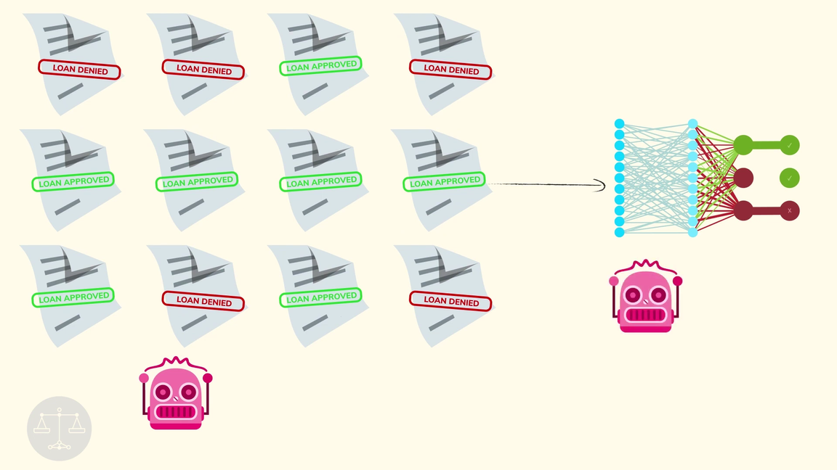


Real-world Example of AI Bias
Predictions and Outputs are extreamly reliant on training data
Bad data -> Bad Algorithm -> Unfair output
Common well represented systems - Windows
AI correctly detecting a vulnerability
lesser-known system - old Linux
AI missing a vulnerability
Ranasinghe R.A.D.T.M

Slide 15

Ensuring Fairness in AI Penetration Testing
Criteria | Traditional Testing | AI Testing with Bias | AI Testing without Bias
Coverage | Limited by human expertise. | Focuses on popular systems, misses others. | Equal coverage across all systems.
Accuracy | High but prone to human error in unknown areas. | Accurate in familiar areas, poor in others. | Consistent accuracy across all platforms.
Human Involvement | High involvement needed. | Needs human oversight for bias correction. | Minimal human involvement required.
Result Consistency | Varies due to human factors. | Inconsistent in less common systems. | Consistent and reliable across all tests.
Ranasinghe R.A.D.T.M

Slide 16


Accountability and Responsibility
Bomal G.D.I

Slide 17


Accountability in AI Penetration Testing: A Complex Issue
AI decisions in penetration testing impact systems, data, and security.
Developers, organizations, and AI systems play distinct roles.
Accountability becomes crucial when AI systems make errors or biased decisions.
Accountability is shared, but responsibility varies across the AI development and implementation lifecycle.
Bomal G.D.I

Slide 18
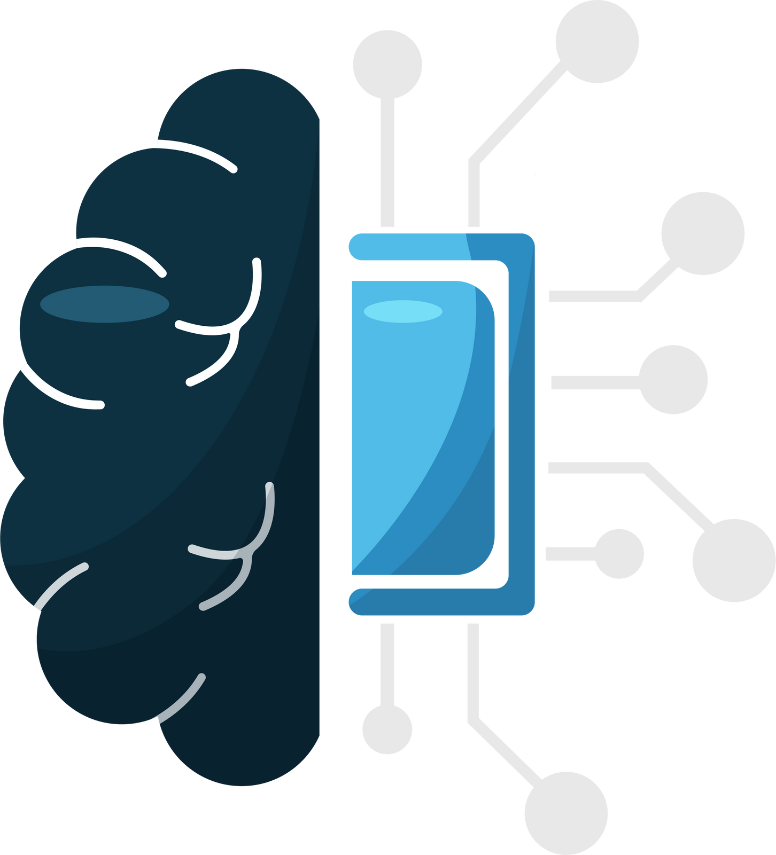
Key Players in AI Accountability: Who’s Responsible?
Developers:
Responsible for AI system design, performance, and built-in ethical considerations.
Accountable for ensuring transparency and mitigating algorithmic bias.
1
Organizations:
Ensure AI tools are used ethically, tested rigorously, and human oversight is maintained.
Liable for the consequences of deploying AI systems
2
AI Systems:
Perform tasks autonomously but cannot bear legal responsibility, their decisions trace back to human stakeholders.
3
Bomal G.D.I

Slide 19



Implementing Accountability: Best Practices in AI Penetration Testing
Regular Audits of AI systems to identify errors or biases early.
Keep a
human-in-the-loop for critical AI decisions.
Ensure
developers adhere to ethical AI practices.
Establish clear lines of responsibility for AI outcomes.
These steps ensure AI is used responsibly and transparently
Bomal G.D.I

Slide 20
AI's Impact on Cybersecurity Jobs and Skills
Rathnayaka R.D.D.H

Slide 21


🔄 Automation of Routine Tasks
⚠️ Job Displacement Concerns
AI automates tasks like vulnerability scanning, delivering faster results.
Cybersecurity professionals can now focus more on strategic decisions.
While AI enhances productivity, it may reduce demand for certain roles.
Staying relevant requires professionals to continuously learn new skills.
🛠️ Changing Responsibilities
AI shifts the focus from routine tasks to advanced analysis.
Professionals are required to interpret AI outputs for actionable insights
Impact on Job Roles in Cybersecurity
Rathnayaka R.D.D.H

Slide 22
1. 📊 Understanding AI and Machine Learning
New Skill Sets Required
AI Understanding: Professionals must grasp AI principles and algorithms.
Data Insights: Ability to interpret AI-generated data for effective decision-making.
🔍 Ethics & Compliance
Regulatory Knowledge: Understanding data privacy laws and ethical standards.
Responsible AI Use: Ensuring ethical deployment of AI in penetration testing.
🌐 Blending Disciplines
Cross-Skilling: Merging cybersecurity with data science and programming (e.g., Python).
Tools Proficiency: Familiarity with key data analysis tools enhances effectiveness.
Rathnayaka R.D.D.H

Slide 23
Thankyou

